Slide 1
Vigenère Tableau Cipher

Slide 2
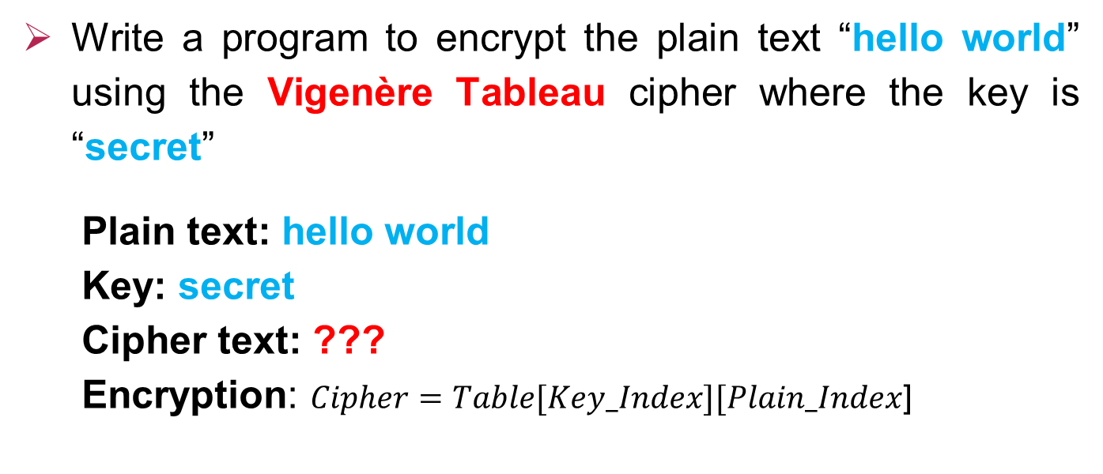
Encryption
Write a program to encrypt the plain text “hello world” using the Vigenère Tableau cipher where the key is “secret”
Plain text: hello world
Key: secret
Cipher text: ???
Encryption: $Cipher=Table[Key_Index][Plain_Index$]

Slide 3
 | 0 | 1 | 2 | 3 | 4 | 5 | 6 | 7 | 8 | 9 | 10 | 11 | 12 | 13 | 14 | 15 | 16 | 17 | 18 | 19 | 20 | 21 | 22 | 23 | 24 | 25
0 | a | b | c | d | e | f | g | h | i | j | k | l | m | n | o | p | q | r | s | t | u | v | w | x | y | z
1 | b | c | d | e | f | g | h | i | j | k | l | m | n | o | p | q | r | s | t | u | v | w | x | y | z | a
2 | c | d | e | f | g | h | i | j | k | l | m | n | o | p | q | r | s | t | u | v | w | x | y | z | a | b
3 | d | e | f | g | h | i | j | k | l | m | n | o | p | q | r | s | t | u | v | w | x | y | z | a | b | c
4 | e | f | g | h | i | j | k | l | m | n | o | p | q | r | s | t | u | v | w | x | y | z | a | b | c | d
5 | f | g | h | i | j | k | l | m | n | o | p | q | r | s | t | u | v | w | x | y | z | a | b | c | d | e
6 | g | h | i | j | k | l | m | n | o | p | q | r | s | t | u | v | w | x | y | z | a | b | c | d | e | f
7 | h | i | j | k | l | m | n | o | p | q | r | s | t | u | v | w | x | y | z | a | b | c | d | e | f | g
8 | i | j | k | l | m | n | o | p | q | r | s | t | u | v | w | x | y | z | a | b | c | d | e | f | g | h
9 | j | k | l | m | n | o | p | q | r | s | t | u | v | w | x | y | z | a | b | c | d | e | f | g | h | i
10 | k | l | m | n | o | p | q | r | s | t | u | v | w | x | y | z | a | b | c | d | e | f | g | h | i | j
11 | l | m | n | o | p | q | r | s | t | u | v | w | x | y | z | a | b | c | d | e | f | g | h | i | j | k
12 | m | n | o | p | q | r | s | t | u | v | w | x | y | z | a | b | c | d | e | f | g | h | i | j | k | l
13 | n | o | p | q | r | s | t | u | v | w | x | y | z | a | b | c | d | e | f | g | h | i | j | k | l | m
14 | o | p | q | r | s | t | u | v | w | x | y | z | a | b | c | d | e | f | g | h | i | j | k | l | m | n
15 | p | q | r | s | t | u | v | w | x | y | z | a | b | c | d | e | f | g | h | i | j | k | l | m | n | o
16 | q | r | s | t | u | v | w | x | y | z | a | b | c | d | e | f | g | h | i | j | k | l | m | n | o | p
17 | r | s | t | u | v | w | x | y | z | a | b | c | d | e | f | g | h | i | j | k | l | m | n | o | p | q
18 | s | t | u | v | w | x | y | z | a | b | c | d | e | f | g | h | i | j | k | l | m | n | o | p | q | r
19 | t | u | v | w | x | y | z | a | b | c | d | e | f | g | h | i | j | k | l | m | n | o | p | q | r | s
20 | u | v | w | x | y | z | a | b | c | d | e | f | g | h | i | j | k | l | m | n | o | p | q | r | s | t
21 | v | w | x | y | z | a | b | c | d | e | f | g | h | i | j | k | l | m | n | o | p | q | r | s | t | u
22 | w | x | y | z | a | b | c | d | e | f | g | h | i | j | k | l | m | n | o | p | q | r | s | t | u | v
23 | x | y | z | a | b | c | d | e | f | g | h | i | j | k | l | m | n | o | p | q | r | s | t | u | v | w
24 | y | z | a | b | c | d | e | f | g | h | i | j | k | l | m | n | o | p | q | r | s | t | u | v | w | x
25 | z | a | b | c | d | e | f | g | h | i | j | k | l | m | n | o | p | q | r | s | t | u | v | w | x | y

Slide 4

0 | 1 | 2 | 3 | 4 | 5 | 6 | 7 | 8 | 9 | 10 | 11 | 12 | 13 | 14 | 15 | 16 | 17 | 18 | 19 | 20 | 21 | 22 | 23 | 24 | 25
a | b | c | d | e | f | g | h | i | j | k | l | m | n | o | p | q | r | s | t | u | v | w | x | y | z
Plain text
h | e | l | l | o | w | o | r | l | d
7 | 4 | 11 | 11 | 14 | 22 | 14 | 17 | 11 | 3
Column
Key
s | e | c | r | e | t | s | e | c | r
18 | 4 | 2 | 17 | 4 | 19 | 18 | 4 | 2 | 17
Row
$$Cipher text = Table [\text{Key}\text{_}\text{Ind} ][Plain_Ind]$$
T[18][7] | T[4][4] | T[2][11] | T[17][11] | T[4][14] | T[19][22] | T[18][14] | T[4][17] | T[2][11] | T[17][3]
z | i | n | c | s | p | g | v | n | u
Cipher text

Slide 5
 | 0 | 1 | 2 | 3 | 4 | 5 | 6 | 7 | 8 | 9 | 10 | 11 | 12 | 13 | 14 | 15 | 16 | 17 | 18 | 19 | 20 | 21 | 22 | 23 | 24 | 25
0 | a | b | c | d | e | f | g | h | i | j | k | l | m | n | o | p | q | r | s | t | u | v | w | x | y | z
1 | b | c | d | e | f | g | h | i | j | k | l | m | n | o | p | q | r | s | t | u | v | w | x | y | z | a
2 | c | d | e | f | g | h | i | j | k | l | m | n | o | p | q | r | s | t | u | v | w | x | y | z | a | b
3 | d | e | f | g | h | i | j | k | l | m | n | o | p | q | r | s | t | u | v | w | x | y | z | a | b | c
4 | e | f | g | h | i | j | k | l | m | n | o | p | q | r | s | t | u | v | w | x | y | z | a | b | c | d
5 | f | g | h | i | j | k | l | m | n | o | p | q | r | s | t | u | v | w | x | y | z | a | b | c | d | e
6 | g | h | i | j | k | l | m | n | o | p | q | r | s | t | u | v | w | x | y | z | a | b | c | d | e | f
7 | h | i | j | k | l | m | n | o | p | q | r | s | t | u | v | w | x | y | z | a | b | c | d | e | f | g
8 | i | j | k | l | m | n | o | p | q | r | s | t | u | v | w | x | y | z | a | b | c | d | e | f | g | h
9 | j | k | l | m | n | o | p | q | r | s | t | u | v | w | x | y | z | a | b | c | d | e | f | g | h | i
10 | k | l | m | n | o | p | q | r | s | t | u | v | w | x | y | z | a | b | c | d | e | f | g | h | i | j
11 | l | m | n | o | p | q | r | s | t | u | v | w | x | y | z | a | b | c | d | e | f | g | h | i | j | k
12 | m | n | o | p | q | r | s | t | u | v | w | x | y | z | a | b | c | d | e | f | g | h | i | j | k | l
13 | n | o | p | q | r | s | t | u | v | w | x | y | z | a | b | c | d | e | f | g | h | i | j | k | l | m
14 | o | p | q | r | s | t | u | v | w | x | y | z | a | b | c | d | e | f | g | h | i | j | k | l | m | n
15 | p | q | r | s | t | u | v | w | x | y | z | a | b | c | d | e | f | g | h | i | j | k | l | m | n | o
16 | q | r | s | t | u | v | w | x | y | z | a | b | c | d | e | f | g | h | i | j | k | l | m | n | o | p
17 | r | s | t | u | v | w | x | y | z | a | b | c | d | e | f | g | h | i | j | k | l | m | n | o | p | q
18 | s | t | u | v | w | x | y | z | a | b | c | d | e | f | g | h | i | j | k | l | m | n | o | p | q | r
19 | t | u | v | w | x | y | z | a | b | c | d | e | f | g | h | i | j | k | l | m | n | o | p | q | r | s
20 | u | v | w | x | y | z | a | b | c | d | e | f | g | h | i | j | k | l | m | n | o | p | q | r | s | t
21 | v | w | x | y | z | a | b | c | d | e | f | g | h | i | j | k | l | m | n | o | p | q | r | s | t | u
22 | w | x | y | z | a | b | c | d | e | f | g | h | i | j | k | l | m | n | o | p | q | r | s | t | u | v
23 | x | y | z | a | b | c | d | e | f | g | h | i | j | k | l | m | n | o | p | q | r | s | t | u | v | w
24 | y | z | a | b | c | d | e | f | g | h | i | j | k | l | m | n | o | p | q | r | s | t | u | v | w | x
25 | z | a | b | c | d | e | f | g | h | i | j | k | l | m | n | o | p | q | r | s | t | u | v | w | x | y

Slide 6
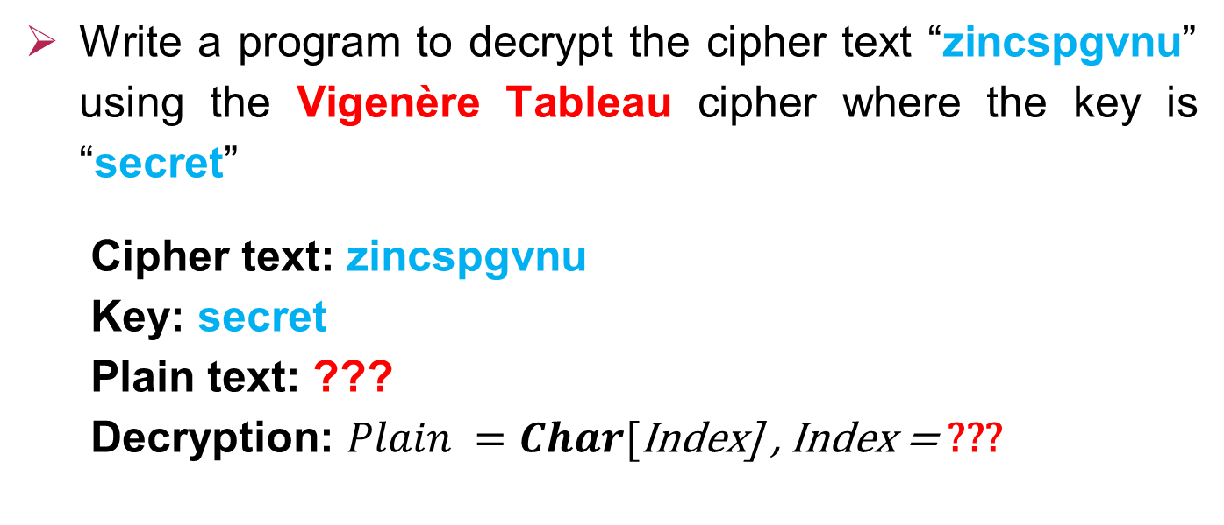
Decryption
Write a program to decrypt the cipher text “zincspgvnu” using the Vigenère Tableau cipher where the key is “secret”
Cipher text: zincspgvnu
Key: secret
Plain text: ???
Decryption: $Plain =Char[\text{Index}\text{] , }\text{Index}\text{ = }\text{???}$

Slide 7
0 | 1 | 2 | 3 | 4 | 5 | 6 | 7 | 8 | 9 | 10 | 11 | 12 | 13 | 14 | 15 | 16 | 17 | 18 | 19 | 20 | 21 | 22 | 23 | 24 | 25
a | b | c | d | e | f | g | h | i | j | k | l | m | n | o | p | q | r | s | t | u | v | w | x | y | z
Cipher text
z | i | n | c | s | p | g | v | n | u
Key
s | e | c | r | e | t | s | e | c | r
18 | 4 | 2 | 17 | 4 | 19 | 18 | 4 | 2 | 17
Row
$$Plain text =Char[\text{Index}\text{] , }$$
$$\text{Index}\text{=}\text{Column} \text{number} \text{of} \text{cipher} \text{character} \text{where} \text{row}\text{=}\text{Key}\text{_}\text{Index} \text{in} \text{the} \text{table}$$
Plain text
h | e | l | l | o | w | o | r | l | d

Slide 8
 | 0 | 1 | 2 | 3 | 4 | 5 | 6 | 7 | 8 | 9 | 10 | 11 | 12 | 13 | 14 | 15 | 16 | 17 | 18 | 19 | 20 | 21 | 22 | 23 | 24 | 25
0 | a | b | c | d | e | f | g | h | i | j | k | l | m | n | o | p | q | r | s | t | u | v | w | x | y | z
1 | b | c | d | e | f | g | h | i | j | k | l | m | n | o | p | q | r | s | t | u | v | w | x | y | z | a
2 | c | d | e | f | g | h | i | j | k | l | m | n | o | p | q | r | s | t | u | v | w | x | y | z | a | b
3 | d | e | f | g | h | i | j | k | l | m | n | o | p | q | r | s | t | u | v | w | x | y | z | a | b | c
4 | e | f | g | h | i | j | k | l | m | n | o | p | q | r | s | t | u | v | w | x | y | z | a | b | c | d
5 | f | g | h | i | j | k | l | m | n | o | p | q | r | s | t | u | v | w | x | y | z | a | b | c | d | e
6 | g | h | i | j | k | l | m | n | o | p | q | r | s | t | u | v | w | x | y | z | a | b | c | d | e | f
7 | h | i | j | k | l | m | n | o | p | q | r | s | t | u | v | w | x | y | z | a | b | c | d | e | f | g
8 | i | j | k | l | m | n | o | p | q | r | s | t | u | v | w | x | y | z | a | b | c | d | e | f | g | h
9 | j | k | l | m | n | o | p | q | r | s | t | u | v | w | x | y | z | a | b | c | d | e | f | g | h | i
10 | k | l | m | n | o | p | q | r | s | t | u | v | w | x | y | z | a | b | c | d | e | f | g | h | i | j
11 | l | m | n | o | p | q | r | s | t | u | v | w | x | y | z | a | b | c | d | e | f | g | h | i | j | k
12 | m | n | o | p | q | r | s | t | u | v | w | x | y | z | a | b | c | d | e | f | g | h | i | j | k | l
13 | n | o | p | q | r | s | t | u | v | w | x | y | z | a | b | c | d | e | f | g | h | i | j | k | l | m
14 | o | p | q | r | s | t | u | v | w | x | y | z | a | b | c | d | e | f | g | h | i | j | k | l | m | n
15 | p | q | r | s | t | u | v | w | x | y | z | a | b | c | d | e | f | g | h | i | j | k | l | m | n | o
16 | q | r | s | t | u | v | w | x | y | z | a | b | c | d | e | f | g | h | i | j | k | l | m | n | o | p
17 | r | s | t | u | v | w | x | y | z | a | b | c | d | e | f | g | h | i | j | k | l | m | n | o | p | q
18 | s | t | u | v | w | x | y | z | a | b | c | d | e | f | g | h | i | j | k | l | m | n | o | p | q | r
19 | t | u | v | w | x | y | z | a | b | c | d | e | f | g | h | i | j | k | l | m | n | o | p | q | r | s
20 | u | v | w | x | y | z | a | b | c | d | e | f | g | h | i | j | k | l | m | n | o | p | q | r | s | t
21 | v | w | x | y | z | a | b | c | d | e | f | g | h | i | j | k | l | m | n | o | p | q | r | s | t | u
22 | w | x | y | z | a | b | c | d | e | f | g | h | i | j | k | l | m | n | o | p | q | r | s | t | u | v
23 | x | y | z | a | b | c | d | e | f | g | h | i | j | k | l | m | n | o | p | q | r | s | t | u | v | w
24 | y | z | a | b | c | d | e | f | g | h | i | j | k | l | m | n | o | p | q | r | s | t | u | v | w | x
25 | z | a | b | c | d | e | f | g | h | i | j | k | l | m | n | o | p | q | r | s | t | u | v | w | x | y

Slide 9
Thanks!

